Slide 1
AIDI 1010 – Introduction to Emerging Technologies WEEK 08
Jahanzeb Abbas (JB)

Slide 2
Week Objectives
(A) Quantum Physics/Mechanics
Important Concepts
(B) Quantum Computing
In light of Quantum Mechanics
(C) QuTiP
(D) QisKit
(E) Examples
(F) References

Slide 3
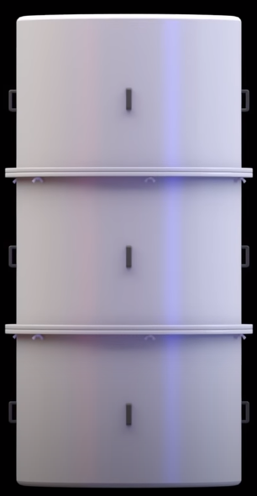
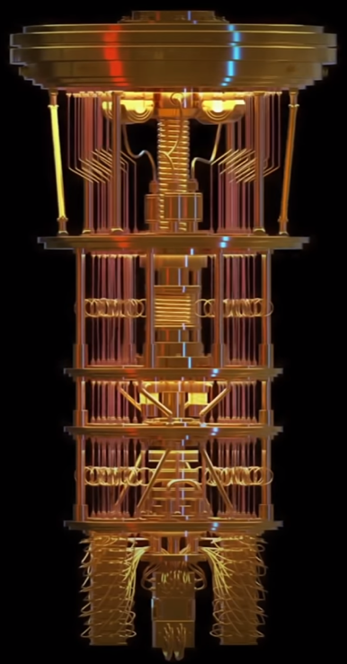
Quantum Computers…

Slide 4
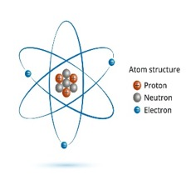
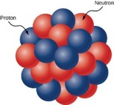
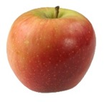
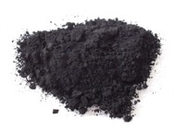
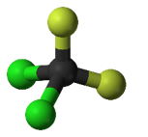
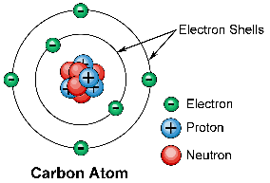
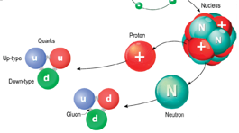
(A) Quantum Physics (What is it?)
Our universe is made up of…
Matter/Mass
Elements/Compounds
Molecules (Electrostatic Forces)
Atoms
Electrons (-ve charge)
Nucleus
Protons (+ve charge) and its Quarks
Neutrons and its Quarks
https://images.theconversation.com/files/247813/original/file-20181128-32221-536vvw.jpg?ixlib=rb-1.1.0&q=45&auto=format&w=1000&fit=clip
https://awo.aws.org/wp-content/uploads/2015/09/Electron-Shell.png
https://opentextbc.ca/universityphysicsv3openstax/wp-content/uploads/sites/273/2019/07/CNX_UPhysics_43_01_Nucleus-1.jpg
https://www.nap.edu/read/25171/chapter/3#15

Slide 5
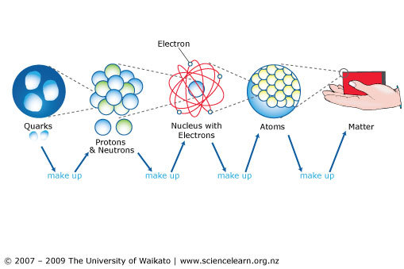
(A) Quantum Physics (What is it?)
Quantum Physics/Mechanics is a branch of Science, specifically, Physics, that describes the smallest things in our universe

Slide 6
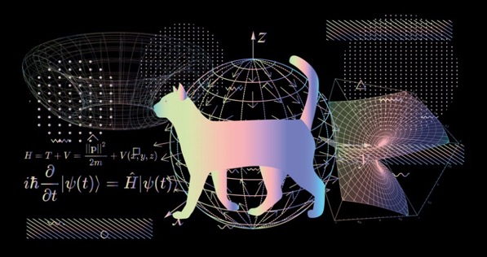

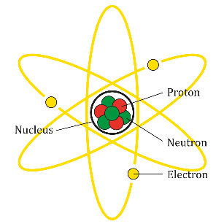
(A) Quantum Physics (What is it?)
Quantum Physics (same as Quantum Mechanics) –
The study of matter and energy at its most fundamental level. A central tenet of quantum physics is that energy comes in indivisible packets called quanta. Quanta behave very differently to macroscopic matter: particles can behave like waves, and waves behave as though they are particles.
Uses of Quantum Physics Today –
Computers, Cameras, LED screens, Nuclear Power Plants

Slide 7
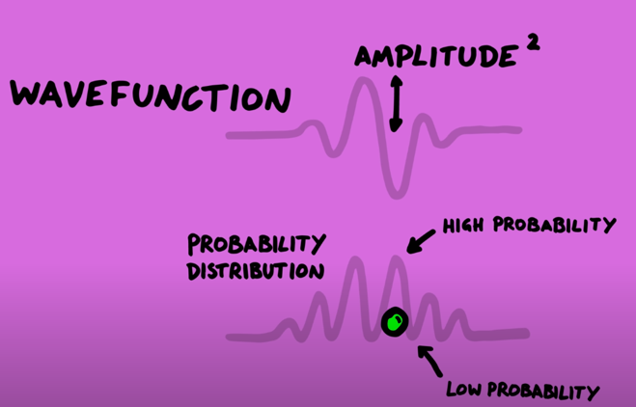


(A) Quantum Physics (What is it?)
Quantum Physics (same as Quantum Mechanics) –
Elements are described as “waves” instead of particles
“Wave function” – hypothetical wave, not an actual wave
“Quantum Wave” is an abstract mathematical description
To understand real-world positional movement of an electron, we have to perform mathematical operations on this wave function
Particle
Wave
https://youtu.be/Usu9xZfabPM

Slide 8
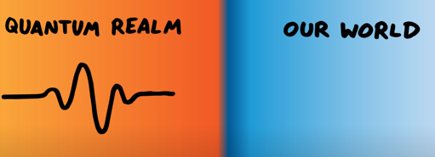
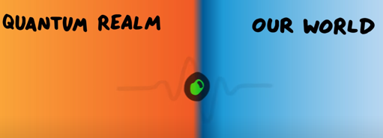
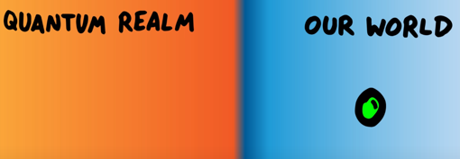
(A) Quantum Physics (What is it?)
Quantum Physics (same as Quantum Mechanics) –
Quantum Physics can never give us infinite details, we can only predict probabilities that things will happen
Fundamental feature of the universe is that it’s random as compared to Classical Physics
Wave functions can predict how subatomic particles will do incredibly well; however, we can’t tell if this wave function is real or not; no one has ever physical seen a “Quantum Wave” either (since upon measuring an electron we only see a “point-like” electron particle rather than a wave)
Waves exist in
“Hidden” Quantum Realm
Measurement Barrier
“Gap in Knowledge”
Waves turn into particles in “Our conceivable World”
https://youtu.be/Usu9xZfabPM

Slide 9
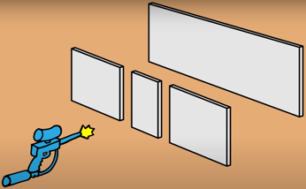
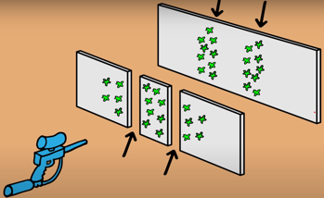

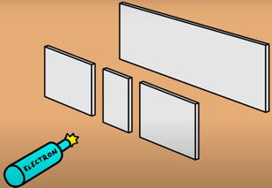
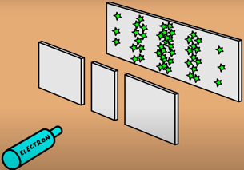
(A) Quantum Physics (What is it?)
Quantum Physics (same as Quantum Mechanics) –
How can you actually picture an electron?
It’s a wave, until you measure it, then it’s a particle
What actually is it? A Wave or Particle? (aka Particle Wave Duality), in come’s the double slit experiment.
“CLASSICAL MECHANICS”
“QUANTUM MECHANICS”
Imagine spraying a paint ball gun with two openings..
You’d expect to see two columns of paint go through the holes and hit the wall behind
Shrink this down to an electron level
The observations become different.
Fire one electron at a time, and they will appear at the back wall; however, …
You get a whole pattern of stripes as they buildup overtime, instead of just two bands.. its called ‘interference pattern..
https://youtu.be/Usu9xZfabPM

Slide 10
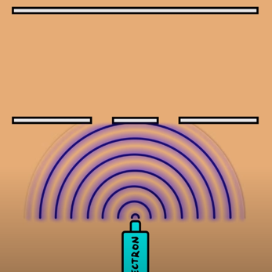
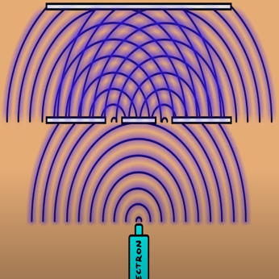
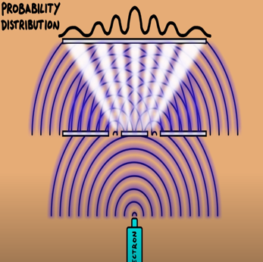
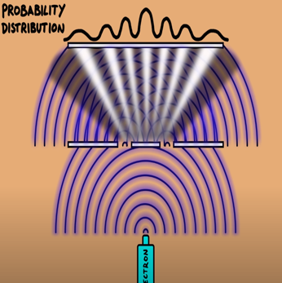
(A) Quantum Physics (What is it?)
Quantum Physics (same as Quantum Mechanics) –
What actually is it? A Wave or Particle? (aka Particle Wave Duality)
The electron wave goes through the both slits at the same time..
.. and the waves from each slit overlap with each other..
.. and where the waves add together - you have a high probability of the electron appearing at the wall.
.. and where the waves cancel out - you have a low probability of the electron appearing at the wall.
https://youtu.be/Usu9xZfabPM

Slide 11
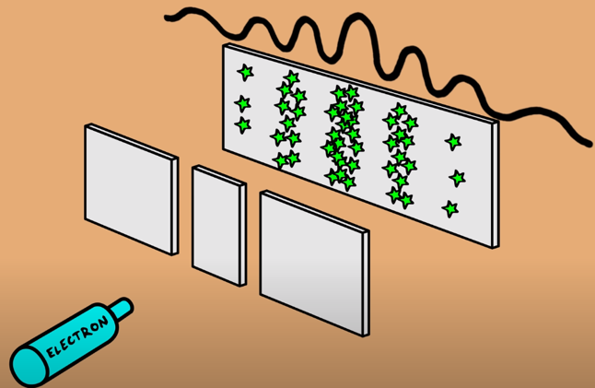
(A) Quantum Physics (What is it?)
Quantum Physics (same as Quantum Mechanics) –
When you fire one electron after another, they follow this probability distribution
This interference pattern starts building up – which is seen in many experiments
This shows that electrons behave like waves, but…
https://youtu.be/Usu9xZfabPM

Slide 12
(A) Quantum Physics (What is it?)
Quantum Physics (same as Quantum Mechanics) –
.. but this doesn’t answer the question how waves turn into particles
No one knows!
Physicists have come up with many theories or interpretations of this phenomenon but haven’t proven otherwise.
Spontaneous Collapse Theory
Bohemian Mechanics / Pilot Wave Theory
Many Worlds Theory
This principle is applicable to everything in the known universe.
https://youtu.be/Usu9xZfabPM

Slide 13
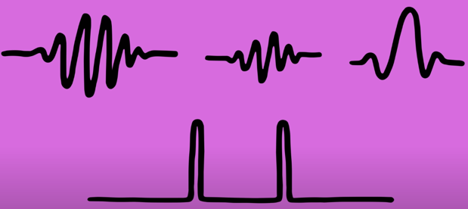
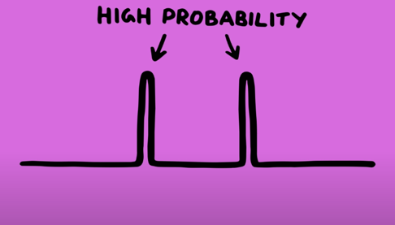
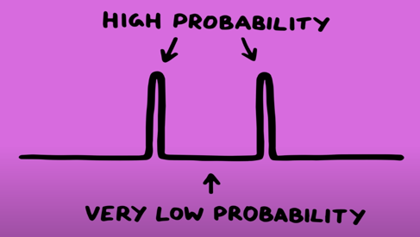
(A) Quantum Physics (What is it?)
Quantum Physics (same as Quantum Mechanics) –
Superposition – The feature of a quantum system whereby it exists in several separate quantum states at the same time.
There are different wave functions for an electron..
Electron has a high probability of being at either waves..
.. and has a very low probability of being here as well.
“Things can be at two places at once”
aka
“Superposition” (adding together of waves)
https://youtu.be/Usu9xZfabPM

Slide 14





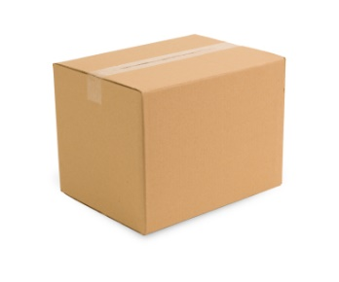





(A) Quantum Physics (What is it?)
Quantum Physics (same as Quantum Mechanics) –
Superposition – Schrodinger’s Cat (Thought-experiment by Erwin Schrodinger)
1
Until we re-open the lid, there’s no way of knowing whether the bomb exploded or not.
2
50% chance of blowing up (after lid is closed)
50% chance of not blowing up (after lid is closed)
Until we re-open the lid, there’s no way of knowing whether the cat is alive or dead
https://youtu.be/z1GCnycbMeA

Slide 15








(A) Quantum Physics (What is it?)
Quantum Physics (same as Quantum Mechanics) –
Superposition – Before our observation, the cat was in a superposition state.
Neither alive or dead, in a mixture of both possibilities, with a 50% chance for each.
This happens to physical systems at QUANTUM scales.
https://youtu.be/z1GCnycbMeA

Slide 16
(A) Quantum Physics (What is it?)
Quantum Physics (same as Quantum Mechanics) –
Superposition – Take an electron orbiting around a Carbon Atom…
Measure the position.
The electron isn’t really orbiting at all.
It’s sort of everywhere in space, all at once.
It has a probability of being at some places than others.
It’s only after we measure its position that we can pinpoint where it is, at that moment.
.. just like ..
We didn’t know whether the cat was alive or dead until we opened the box.
https://youtu.be/z1GCnycbMeA

Slide 17
(A) Quantum Physics (What is it?)
Quantum Physics (same as Quantum Mechanics) –
Superposition – final thoughts..
In double-slit experiment - when electrons were observed through cameras – they started behaving like particles (rather than waves who maintain a superposition state).
Many experiments have proven how particles have a wave-like pattern (wave-function) and particles are in all the states they can possibly be in, until they are observed.
The bigger the object, the smaller its wavelength.
Things like cats or humans cannot operate in quantum mechanics due to the size and wavelengths.
https://youtu.be/z1GCnycbMeA

Slide 18

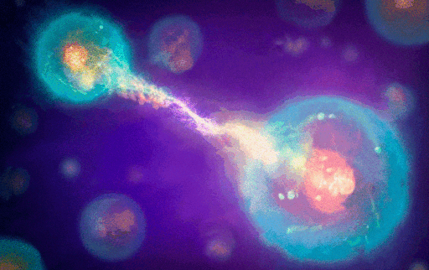
(A) Quantum Physics (What is it?)
Quantum Physics (same as Quantum Mechanics) –
Entangled - To wrap or twist together; interweave; intertwine
Quantum Entanglement – Quantum entanglement is a quantum mechanical phenomenon in which the quantum states of two or more objects have to be described with reference to each other, even though the individual objects may be spatially separated.
https://cosmosmagazine.com/wp-content/uploads/2019/12/211116_entanglement_P-e1610500086158.jpg

Slide 19
(A) Quantum Physics (What is it?)
Quantum Physics (same as Quantum Mechanics) –
Quantum Entanglement – Einstein called it “Spooky action at a distant”, which implies faster than light communication (theory of relativity rules that out).
All particles have a fundamental property of “spin”, which can be measured in directions
Before measuring the spin, particles are usually spinning in any direction (superposition)
To measure the spin, need to specify which direction needs to be measured
Measurement Choice | Measurement Outcomes
Horizontally | Spin will be Left or Right
Vertically | Spin will be Up or Down
https://youtu.be/Usu9xZfabPM

Slide 20
(A) Quantum Physics (What is it?)
Quantum Physics (same as Quantum Mechanics) –
Quantum Entanglement – Correlation between two things.
Superposition State
Box1- Cat Alive | Box2- Cat Dead
Box1- Cat Dead | Box2- Cat Alive
The states of the Cats are entangled.
https://youtu.be/Usu9xZfabPM

Slide 21
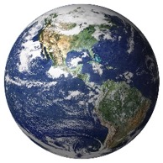
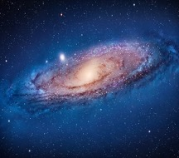
(A) Quantum Physics (What is it?)
Quantum Physics (same as Quantum Mechanics) –
Quantum Entanglement – Correlation between two things.
Superposition State
Box1- Cat Alive | Box2- Cat Dead
Box1- Cat Dead | Box2- Cat Alive
If Box1 has the cat measured to be Alive then Box2’s cat will always be (measured as) Dead due to entanglement, the measurement of Box1’s cat being Alive is information that’s transmitted instantaneously!
This is not just a phenomenon or theory – it has been observed by scientists at a macroscopic scale.
https://youtu.be/Usu9xZfabPM

Slide 22
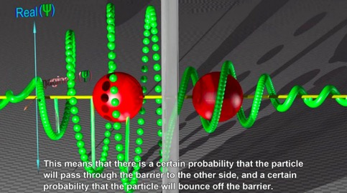
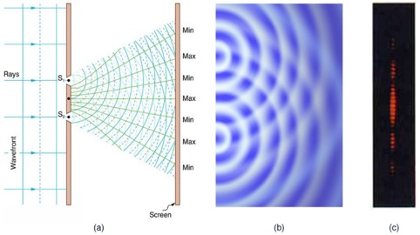
(A) Quantum Physics (What is it?)
Quantum Physics (same as Quantum Mechanics) –
Quantum Tunnelling – is the quantum mechanical phenomenon where a wavefunction can propagate through a potential barrier.
Quantum Interference – is the most challenging concept but helps to understand why superposition exists, how wave functions cancel each other to understand measurement.
https://youtu.be/Usu9xZfabPM

Slide 23
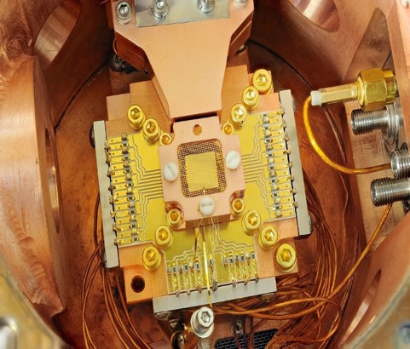

(B) Quantum Computing (What is it?)
Quantum Computing –
Quantum computing is the exploitation of collective properties of quantum states, such as superposition and entanglement, to perform computation.
The devices that perform quantum computations are known as quantum computers. They are believed to be able to solve certain computational problems, such as integer factorization (which underlies RSA encryption), substantially faster than classical computers.
The study of quantum computing is a subfield of quantum information science. [Wikipedia]; https://en.wikipedia.org/wiki/Quantum_computing
Why?
Regular computers run out of space, memory..
Smaller silicon is reaching its limitations due to heat and limitation
Creation of brand new computers based on the laws of quantum mechanics will help expand the silicon limitations (not the next generation of general computers, but something else..)
https://youtu.be/OWJCfOvochA

Slide 24
Quantum Computers…

Slide 25
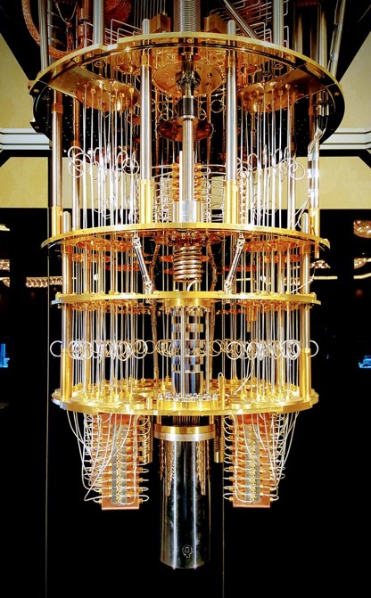
(B) Quantum Computing (What is it?)
Quantum Computers aka Dilution Refrigerator
Has different levels that get progressively colder (10milliKelvin; bottom is coldest where the quantum chip is – which controls the state of qubits)
Makes the quantum chips really cold to achieve quantum state of qubits so that information doesn’t get lost in the environment
Each qubit is a carrier of quantum information; the “state” of the qubit is controlled through microwave pulses; states include:
Put qubits into superposition, Flip the state of qubit from 0 to 1, Entangle the qubits
Quantum Computers building/running:
Have an object, physical device, qubit (quantum bit) that can support a quantum state or manipulate (to be put into super-positions of states); atoms, ions, super-conducting qubits
Superposition, Entanglement, and Interference properties are used within quantum computers
Each quantum computer has an “error correction” protocol to maintain prolonged entanglement between qubits; quantum effects are sensitive to smallest disturbance; they need to operate with several copies of the data
https://youtu.be/OWJCfOvochA

Slide 26
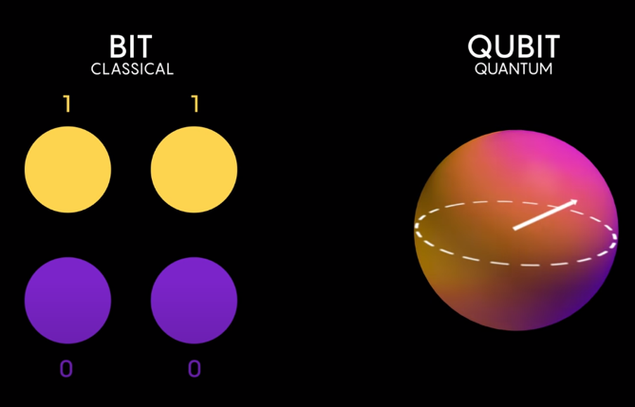
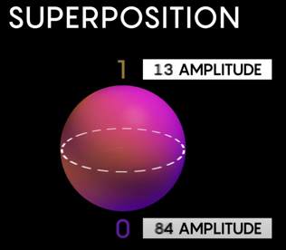
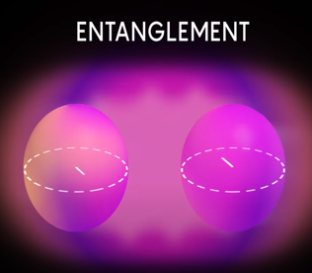
(B) Quantum Computing (What is it?)
Bits & Qubits
Qubit (“Quantum Bit”) is the basic computational unit in Quantum Computing
Bits are Binary (can only be 0 or 1); Qubits (can be 0, 1, or “0 & 1”)
Before measuring a qubit, it exists in a superposition state (aka probability distribution)
Each qubit has a random amplitude for being 0, or a random amplitude for being 1 (fig2)
When two or more qubits are close to each other, and especially in a superposition state – they relate to one another through entanglement (aka correlation) (fig3)
https://youtu.be/jHoEjvuPoB8

Slide 27
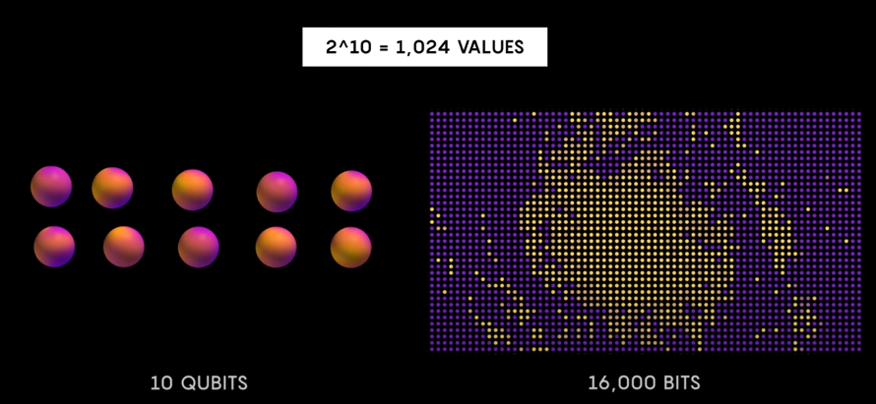
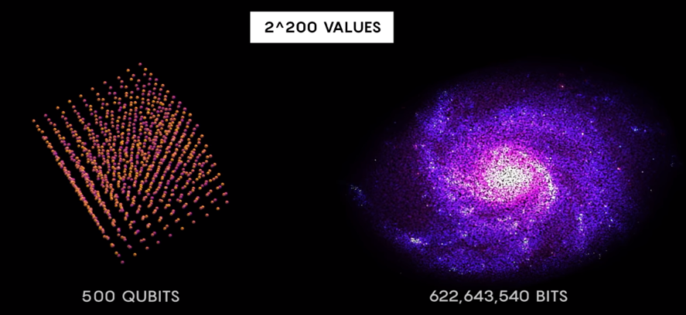
(B) Quantum Computing (What is it?)
https://youtu.be/jHoEjvuPoB8

Slide 28
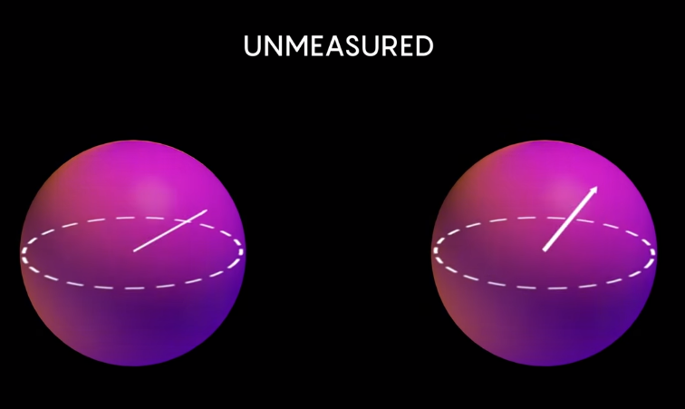
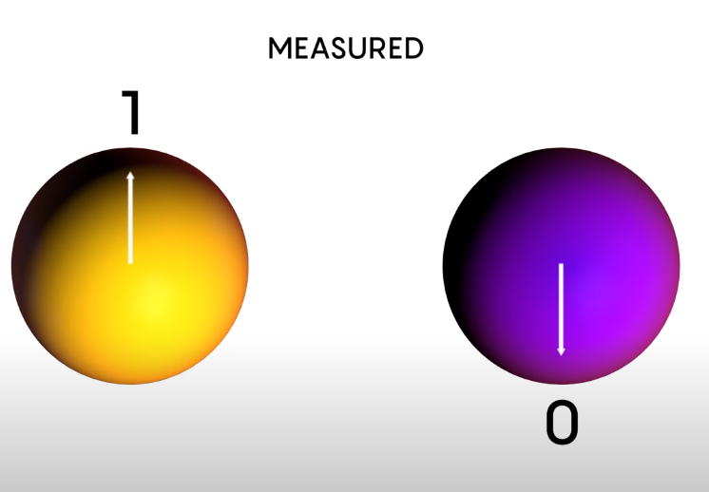
(B) Quantum Computing (What is it?)
Quantum
Classical
https://youtu.be/jHoEjvuPoB8

Slide 29
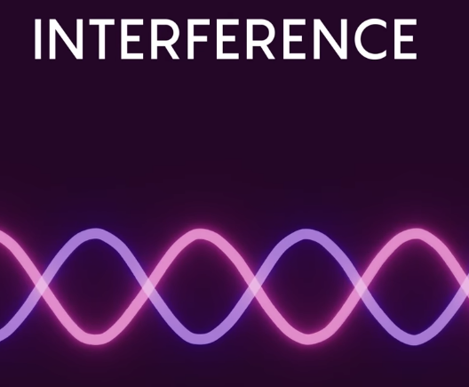
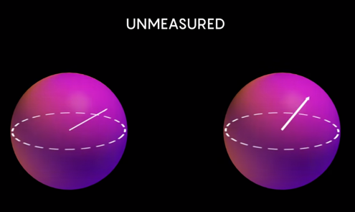

(B) Quantum Computing (What is it?)
Quantum
Classical
Interference is used to capture outcome from probabilities
What amplitudes do when they are added or subtracted
(double slit experiment)
https://youtu.be/jHoEjvuPoB8

Slide 30
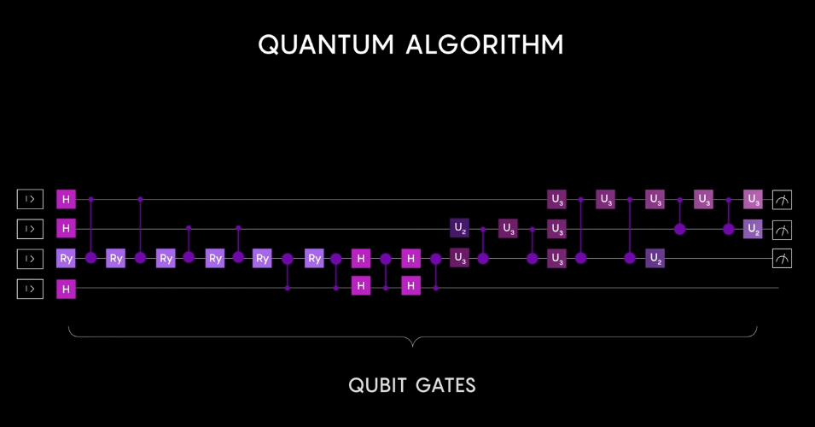
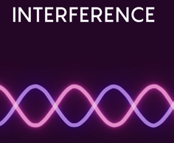
(B) Quantum Computing (What is it?)
Scientists can control interference by creating a deterministic sequence of qubit gates; these gates cause amplitudes to add up constructively; mathematically guaranteed to boost probability of seeing one of the right answers
https://youtu.be/jHoEjvuPoB8

Slide 31
(B) Quantum Computing (What is it?)
Applications of Quantum Computing –
Accelerating calculation of prime factorization, quantum simulation, search optimization, algebraic programs like Machine Learning and large-scale computations
Exploring Physics & Other forms of Science
Simulating Quantum Laws onto regular matter, Chemical Bonding (without the need of synthetics), Nature, Space Travel (Wormholes), Cyber Security
Solve logistical and financial systems
Detecting Dark Matter and Gravitational Waves
Don’t know the BEST application for them (yet)
https://youtu.be/OWJCfOvochA

Slide 32
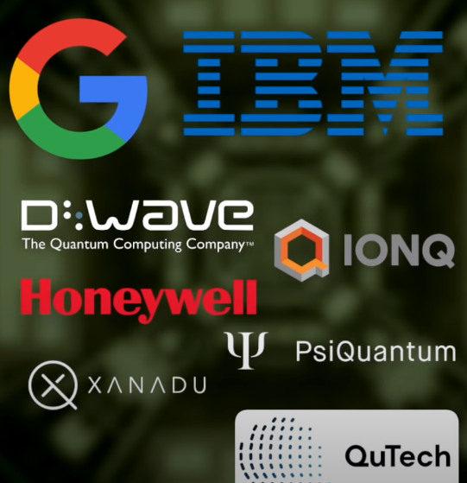
(B) Quantum Computing (What is it?)
Quantum Computing –
Access to Conventional Quantum Computers
Won’t be available anytime soon
Access to Actual Quantum Computers, virtually:
https://quantum-computing.ibm.com/
https://xanadu.ai/cloud
https://cloud.dwavesys.com/leap/login/?next=/leap/
https://www.rigetti.com/qcs
https://youtu.be/OWJCfOvochA & https://youtu.be/OGsu5MIzruw

Slide 33
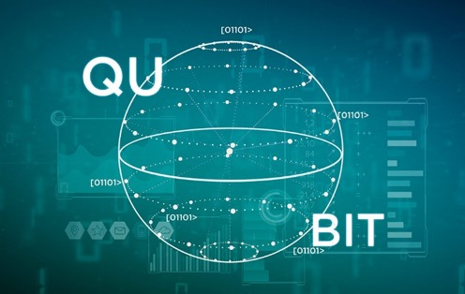
(B) Quantum Computing (What is it?)
Types of Qubits
Superconducting Qubits (the most widely used and advanced)
Small currents on a chip; produced by same techniques as normal chips
Google (53 qubits), IBM (5/16 free, 65 qubits; 1K by 2023), Rigetti
Photonic Quantum Qubits related to photons
Can be operated at room temperature; run by Xanadau & PsiQuantum
Ion Trap Qubits, atoms missing some electrons that have a net negative charge
Trapping & use lasers to entangle them; run by Honeywell (quantum volume of 65), IONQ (32 trapped ions)
D-Wave; only company to sell commercially available quantum computers, also use super conducting qubits; 5,600 qubits!
Can’t be compared to Google/IBM, D-Wave uses a different computation strategy
Topological Quantum Qubits; the wildcard; information would be stored in quasi-particles
This information would be very robust to decoherence
No workable machine uses this technique; proposed by Microsoft (by 2030)
https://youtu.be/jHoEjvuPoB8

Slide 34
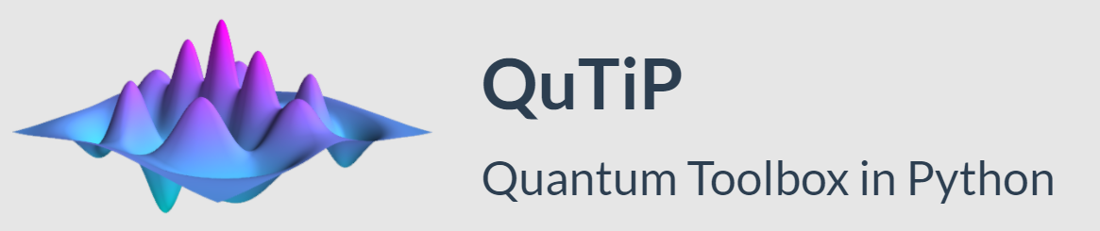

(C) QuTiP (What is it?)
Created by Paul D. Nation and Robert J Johansson in 2011
The Quantum Toolbox in Python, or QuTiP, is an open-source framework written in the Python programming language, designed for simulating the open quantum dynamics of systems such as those listed above.
It’s based off of Numpy, Scipy, and Cython libraries

Slide 35

(C) QuTiP (What is it?)
Used to simulate quantum computing with a classical computer
It can be used to simulate dynamics within quantum systems, which have a lot of noise and disturbance due to interactions between qubits and quantum machine itself
It can help understand how the noise influences outcome of computations in quantum computers
It can help apply pulse (rotation/spin) or a series of pulses to achieve superposition state, while observing magnitude of noise influences on superposition state
It is meant for those who are not physicists
It can perform calculations with quantum objects

Slide 36


(D) Qiskit (What is it?)
Created by IBM Research & Qiskit Community in 2017
Qiskit is an SDK for performing quantum computations that utilize these quantum mechanical principles using the language of quantum circuits.
Qiskit works at the level of circuits, pulses, and algorithms.
It provides tools for creating and manipulating quantum programs and running them on prototype quantum devices on IBM Quantum Experience or on simulators on a local computer.
It follows the circuit model for universal quantum computation, and can be used for any quantum hardware (currently supports superconducting qubits and trapped ions) that follows this model.

Slide 37


(D) Qiskit (What is it?)
Comprised of quantum gates, instructions, and classical control logic, quantum circuits allow for expressing complex algorithms and applications in a abstract manner that can be executed on a quantum computer.
Qiskit is a quantum circuit construction, optimization, and execution engine. Additional algorithm and application layers leverage quantum circuits, often in concert with classical computing resources, to solve problems in optimization, quantum chemistry, physics, machine learning, and finance.
Algorithms and applications that utilize quantum mechanical resources can be easily and efficiently written in the language of quantum circuits.
A quantum circuit is a computational routine consisting of coherent quantum operations on quantum data, such as that held in qubits, and concurrent real-time classical computation. Each horizontal line, or wire in a circuit represents a qubit, with the left end of the wire being the initial quantum data, and the right being the final quantum data generated by the quantum circuit’s computation. Operations on qubits can be placed on these wires, and are represented by boxes.
https://qiskit.org/documentation/qc_intro.html

Slide 38
(D) Qiskit (What is it?)
Quantum circuits enable a quantum computer to take in classical information and output a classical solution, leveraging quantum principles such as interference and entanglement to perform the computation.
A typical quantum algorithm workflow consists of:
The problem we want to solve,
A classical algorithm that generates a description of a quantum circuit,
The quantum circuit that needs to be run on quantum hardware,
And the output classical solution to the problem that it produces.
Quantum gates form the primitive operations on quantum data. Quantum gates represent information preserving, reversible transformations on the quantum data stored in qubits. These “unitary” transformations represent the quantum mechanical core of a quantum circuit.
https://qiskit.org/documentation/qc_intro.html

Slide 39

(E) Examples

Slide 40
Disclaimer
Due to nature of the course, various materials have been compiled from different open source resources with some moderation.
The course designer (slides creator), sincerely acknowledges their hard work and contribution, credit will be given wherever necessary

Slide 41
References
Quantum Physics
https://www.nature.com/subjects/quantum-physics
https://theschools.com/theschools/curriculum/Sample11/s.html
https://youtu.be/Usu9xZfabPM
https://manoa.hawaii.edu/exploringourfluidearth/chemical/chemistry-and-seawater/atoms-and-molecules
https://www.sciencelearn.org.nz/images/2151-structure-of-matter-flow-diagram
https://www.nap.edu/read/25171/chapter/3
https://youtu.be/z1GCnycbMeA
https://youtu.be/JP9KP-fwFhk
https://youtu.be/fkAAbXPEAtU
https://jqi.umd.edu/glossary/quantum-superposition#:~:text=The%20feature%20of%20a%20quantum,type%20of%20intrinsic%20angular%20momentum.&text=Each%20electron%2C%20until%20it%20is,of%20being%20in%20either%20state.
Quantum Computing
https://en.wikipedia.org/wiki/Quantum_computing
https://youtu.be/OWJCfOvochA
https://spectrum.ieee.org/tech-talk/computing/hardware/dwave-launches-free-quantum-cloud-service
https://youtu.be/TwaYHG7vGK4
https://en.wikipedia.org/wiki/Quantum_tunnelling
https://youtu.be/tt8gVXDsh7Q
https://youtu.be/jHoEjvuPoB8
https://youtu.be/OGsu5MIzruw
QuTiP / Qiskit
https://qutip.org/features.html
https://qutip.org/docs/latest/
https://www.activestate.com/blog/emulating-quantum-computing-with-python/
https://qutip.org/docs/latest/modules/qutip/about.html
https://colab.research.google.com/github/jrjohansson/qutip-lectures/blob/master/Lecture-0-Introduction-to-QuTiP.ipynb#scrollTo=7kb-a7YNeWdF
https://qutip.org/docs/3.1.0/guide/guide-states.html
https://qiskit.org/documentation/intro_tutorial1.html & https://qiskit.org/
https://www.reddit.com/r/QuantumComputing/comments/b5q0e2/qiskit_vs_qutip_vs_others_for_quantum_machine/ejfebt5/
https://en.wikipedia.org/wiki/Bra%E2%80%93ket_notation
https://github.com/Qiskit
https://qiskit.org/documentation/qc_intro.html

Slide 42

Thank You Very Much
Any Questions?

